Slide 1
Changes in lectures
22.04.2019 (No Lecture) -> Move to the next week
06.05.2019 (No lecture) -> Move to the next week

Slide 2
Navigation between Activities/Fragments

Slide 3
Introduction to Activities

Slide 4
Introduction to Activities
The Activity class is a crucial component of an Android app, and the way activities are launched and put together is a fundamental part of the platform's application model. Unlike programming paradigms in which apps are launched with a main() method, the Android system initiates code in an Activity instance by invoking specific callback methods that correspond to specific stages of its lifecycle.

Slide 5
Activities
Activities are one of the fundamental building blocks of apps on the Android platform. They serve as the entry point for a user's interaction with an app, and are also central to how a user navigates within an app (as with the Back button) or between apps (as with the Recents button).

Slide 6
Activities
Skillfully managing activities allows you to ensure that, for example:
Orientation changes take place smoothly without disrupting the user experience.
User data is not lost during activity transitions.
The system kills processes when it's appropriate to do so.

Slide 7
Introduction to Activities
Most apps contain multiple screens, which means they comprise multiple activities. Typically, one activity in an app is specified as the main activity, which is the first screen to appear when the user launches the app. Each activity can then start another activity in order to perform different actions. For example, the main activity in a simple e-mail app may provide the screen that shows an e-mail inbox. From there, the main activity might launch other activities that provide screens for tasks like writing e-mails and opening individual e-mails.

Slide 8
activity lifecycle

Slide 9
Managing the activity lifecycle
Over the course of its lifetime, an activity goes through a number of states. You use a series of callbacks to handle transitions between states. The following sections introduce these callbacks.

Slide 10
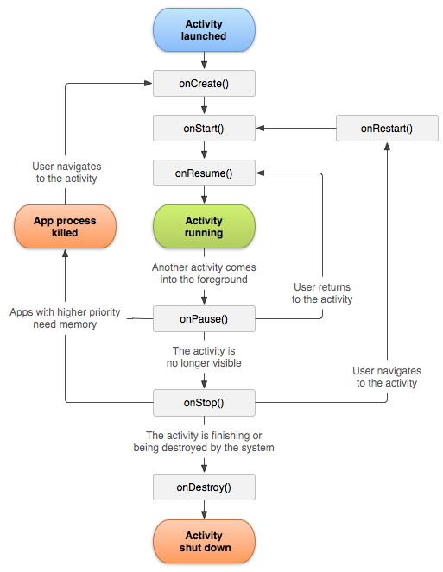

Slide 11
onCreate()
You must implement this callback, which fires when the system creates your activity. Your implementation should initialize the essential components of your activity: For example, your app should create views and bind data to lists here. Most importantly, this is where you must call setContentView() to define the layout for the activity's user interface.
When onCreate() finishes, the next callback is always onStart().

Slide 12
onStart()
As onCreate() exits, the activity enters the Started state, and the activity becomes visible to the user. This callback contains what amounts to the activity’s final preparations for coming to the foreground and becoming interactive.

Slide 13
onResume()
The system invokes this callback just before the activity starts interacting with the user. At this point, the activity is at the top of the activity stack, and captures all user input. Most of an app’s core functionality is implemented in the onResume() method.
The onPause() callback always follows onResume().

Slide 14
onPause()
The system calls onPause() when the activity loses focus and enters a Paused state. This state occurs when, for example, the user taps the Back or Recents button. When the system calls onPause() for your activity, it technically means your activity is still partially visible, but most often is an indication that the user is leaving the activity, and the activity will soon enter the Stopped or Resumed state.
An activity in the Paused state may continue to update the UI if the user is expecting the UI to update. Examples of such an activity include one showing a navigation map screen or a media player playing. Even if such activities lose focus, the user expects their UI to continue updating.
You should not use onPause() to save application or user data, make network calls, or execute database transactions. For information about saving data, see Saving and restoring activity state.
Once onPause() finishes executing, the next callback is either onStop() or onResume(), depending on what happens after the activity enters the Paused state.

Slide 15
onStop()
The system calls onStop() when the activity is no longer visible to the user. This may happen because the activity is being destroyed, a new activity is starting, or an existing activity is entering a Resumed state and is covering the stopped activity. In all of these cases, the stopped activity is no longer visible at all.
The next callback that the system calls is either onRestart(), if the activity is coming back to interact with the user, or by onDestroy() if this activity is completely terminating.

Slide 16
onDestroy()
The system invokes this callback before an activity is destroyed.
This callback is the final one that the activity receives. onDestroy() is usually implemented to ensure that all of an activity’s resources are released when the activity, or the process containing it, is destroyed.

Slide 17
Depending on the complexity of your activity, you probably don't need to implement all the lifecycle methods. However, it's important that you understand each one and implement those that ensure your app behaves the way users expect.

Slide 18
Navigating between activities
An app is likely to enter and exit an activity, perhaps many times, during the app’s lifetime. For example, the user may tap the device’s Back button, or the activity may need to launch a different activity

Slide 19
Navigating between activities

Slide 20
Starting one activity from another
An activity often needs to start another activity at some point. This need arises, for instance, when an app needs to move from the current screen to a new one.
Depending on whether your activity wants a result back from the new activity it’s about to start, you start the new activity using either thestartActivity() or the startActivityForResult() method. In either case, you pass in an Intent object.

Slide 21
Starting one activity from another
startActivity(Activity to show)
startActivityForResult(Activity to show)

Slide 22


Slide 23
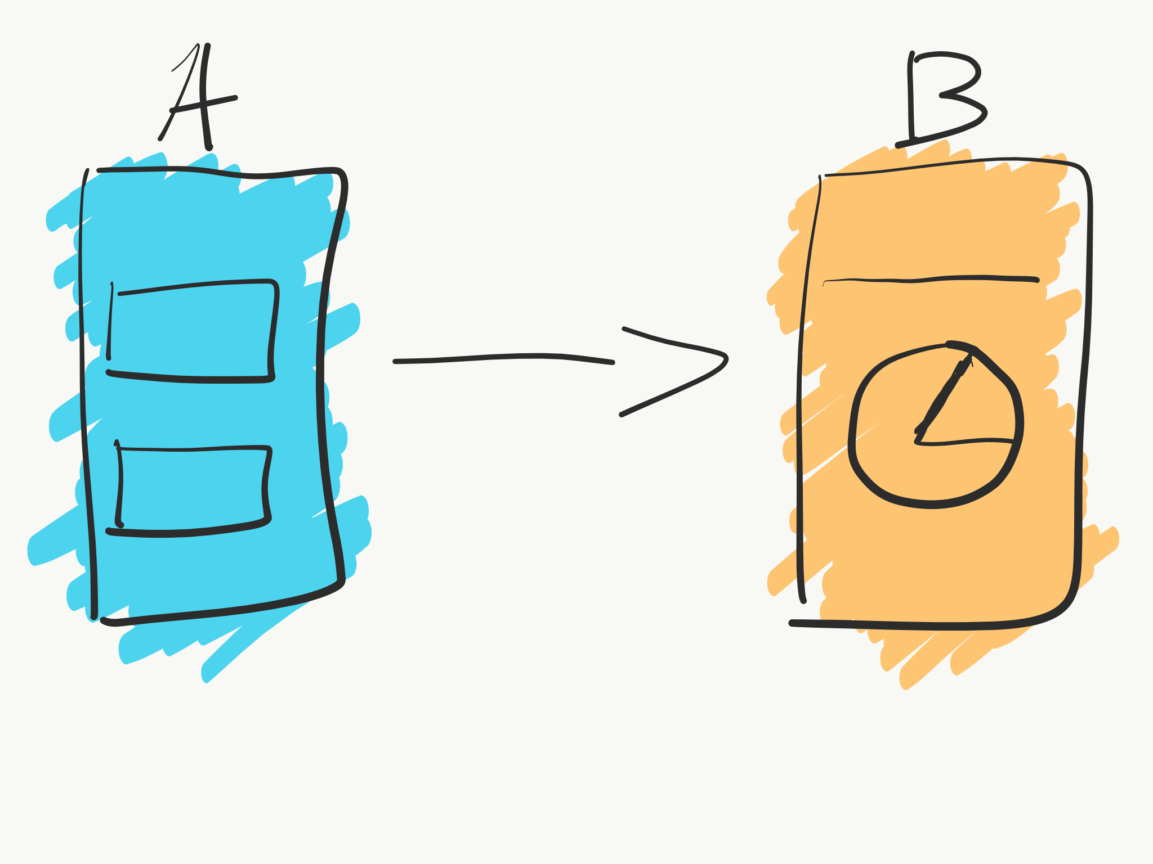

Slide 24
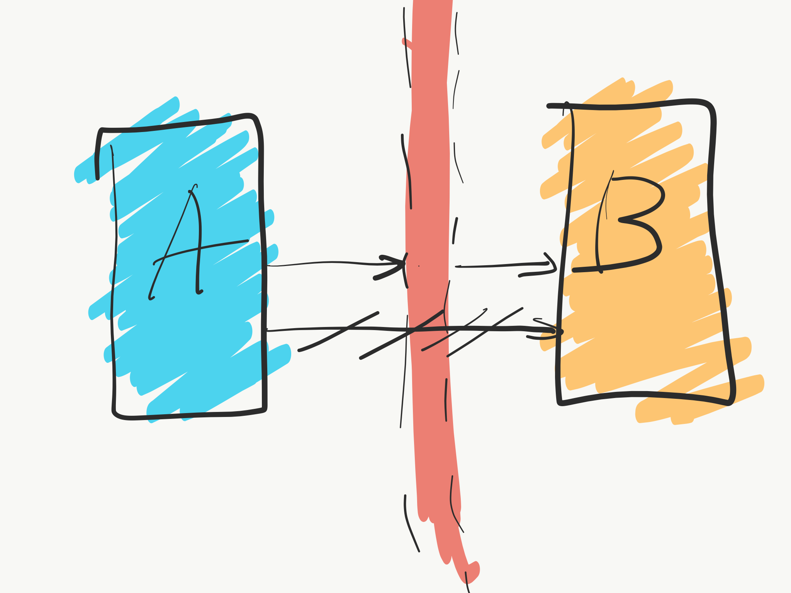

Slide 25
Intent
The Intent object specifies either the exact activity you want to start or describes the type of action you want to perform (and the system selects the appropriate activity for you, which can even be from a different application). An Intent object can also carry small amounts of data to be used by the activity that is started.

Slide 26
Extras
Key-value pairs that carry additional information required to accomplish the requested action. Just as some actions use particular kinds of data URIs, some actions also use particular extras.You can add extra data with various putExtra() methods, each accepting two parameters: the key name and the value. You can also create a Bundle object with all the extra data, then insert the Bundle in the Intent with putExtras().
sendIntent.putExtra(Intent.EXTRA_TEXT, textMessage)

Slide 27
startActivity()
If the newly started activity does not need to return a result, the current activity can start it by calling the startActivity() method.
When working within your own application, you often need to simply launch a known activity. For example, the following code snippet shows how to launch an activity called SignInActivity.
Intent intent = new Intent(this, SignInActivity.class); startActivity(intent);

Slide 28
Share content
Your application might also want to perform some action, such as send an email, text message, or status update, using data from your activity. In this case, your application might not have its own activities to perform such actions, so you can instead leverage the activities provided by other applications on the device, which can perform the actions for you. This is where intents are really valuable: You can create an intent that describes an action you want to perform and the system launches the appropriate activity from another application. If there are multiple activities that can handle the intent, then the user can select which one to use. For example, if you want to allow the user to send an email message, you can create the following intent:
Intent intent = new Intent(Intent.ACTION_SEND); intent.putExtra(Intent.EXTRA_EMAIL, recipientArray); startActivity(intent);

Slide 29
startActivityForResult()
Sometimes you want to get a result back from an activity when it ends. For example, you may start an activity that lets the user pick a person in a list of contacts; when it ends, it returns the person that was selected. To do this, you call the startActivityForResult(Intent, int) method, where the integer parameter identifies the call. This identifier is meant to disambiguate between multiple calls to startActivityForResult(Intent, int)from the same activity. It's not global identifier and is not at risk of conflicting with other apps or activities.The result comes back through youronActivityResult(int, int, Intent) method.

Slide 30
startActivityForResult()
When a child activity exits, it can call setResult(int) to return data to its parent. The child activity must always supply a result code, which can be the standard results RESULT_CANCELED, RESULT_OK, or any custom values starting at RESULT_FIRST_USER. In addition, the child activity can optionally return an Intent object containing any additional data it wants. The parent activity uses the onActivityResult(int, int, Intent) method, along with the integer identifier the parent activity originally supplied, to receive the information.
If a child activity fails for any reason, such as crashing, the parent activity receives a result with the code RESULT_CANCELED.

Slide 31
restoring activity state

Slide 32
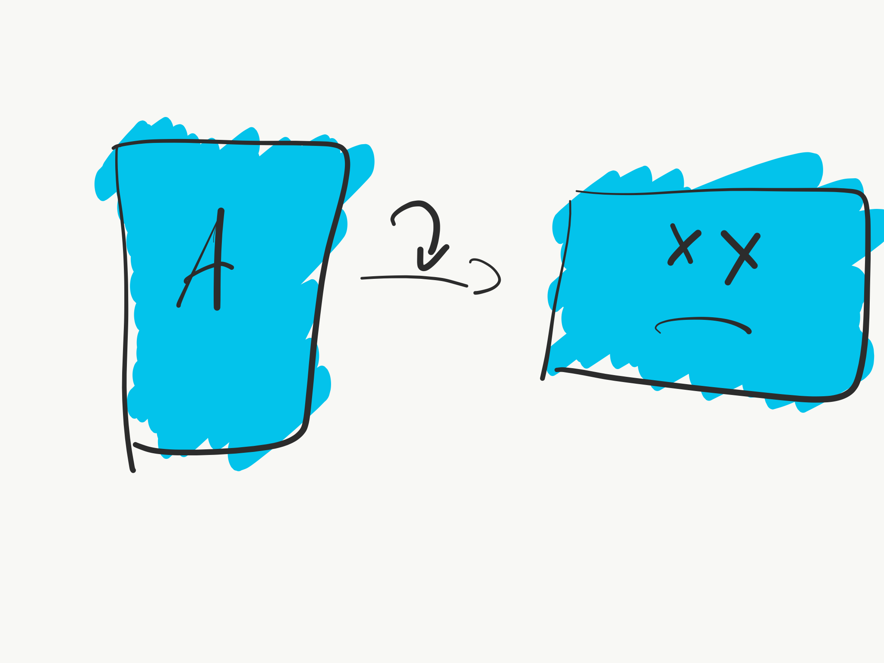

Slide 33
Saving and restoring activity state
There are a few scenarios in which your activity is destroyed due to normal app behavior, such as when the user presses the Back button or your activity signals its own destruction by calling the finish() method. The system may also destroy the process containing your activity to recover memory if the activity is in the Stopped state and hasn't been used in a long time, or if the foreground activity requires more resources.

Slide 34
Saving and restoring activity state
By default, the system uses the Bundle instance state to save information about each View object in your activity layout (such as the text value entered into an EditText widget). So, if your activity instance is destroyed and recreated, the state of the layout is restored to its previous state with no code required by you. However, your activity might have more state information that you'd like to restore, such as member variables that track the user's progress in the activity.
A Bundle object isn't appropriate for preserving more than a trivial amount of data because it consumes system-process memory. To preserve more than a very small amount of data, you should take a combined approach to preserving data, using persistent local storage, theonSaveInstanceState() method, and the ViewModel class.

Slide 35
Save your activity state
As your activity begins to stop, the system calls the onSaveInstanceState() method so your activity can save state information with a collection of key-value pairs. The default implementation of this method saves transient information about the state of the activity's view hierarchy, such as the text in an EditText widget or the scroll position of a ListView widget. Your app should implement the onSaveInstanceState() callback after the onPause() method, and before onStop(). Do not implement this callback in onPause().
Caution: You must always call the superclass implementation of onSaveInstanceState() so the default implementation can save the state of the view hierarchy.

Slide 36
Save your activity state
To save persistent data, such as user preferences or data for a database, you should take appropriate opportunities when your activity is in the foreground. If no such opportunity arises, you should save such data during the onStop() method.

Slide 37
Restore your activity state
When your activity is recreated after it was previously destroyed, you can recover your saved state from the Bundle that the system passes to your activity. Both the onCreate() and onRestoreInstanceState() callback methods receive the same Bundle that contains the instance state information.
Because the onCreate() method is called whether the system is creating a new instance of your activity or recreating a previous one, you must check whether the state Bundle is null before you attempt to read it. If it is null, then the system is creating a new instance of the activity, instead of restoring a previous one that was destroyed.

Slide 38
Restore your activity state
Instead of restoring the state during onCreate() you may choose to implement onRestoreInstanceState(), which the system calls after theonStart() method. The system calls onRestoreInstanceState() only if there is a saved state to restore, so you do not need to check whether the Bundle is null:

Slide 39
Fragments

Slide 40


Slide 41
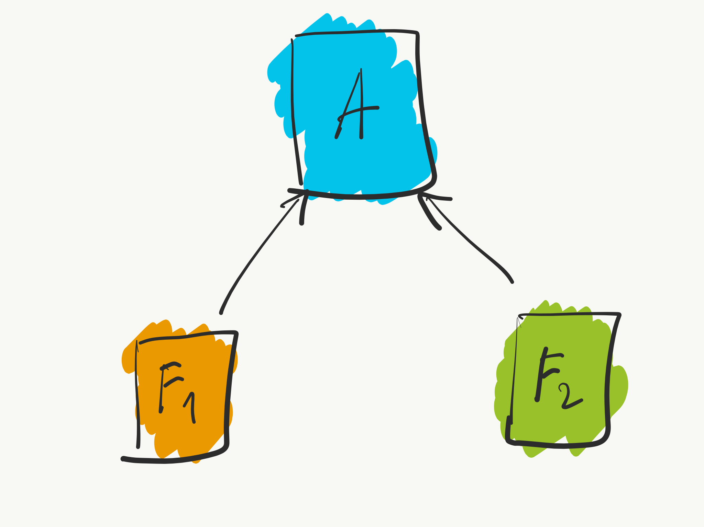

Slide 42


Slide 43
Fragments
A Fragment represents a behavior or a portion of user interface in a FragmentActivity. You can combine multiple fragments in a single activity to build a multi-pane UI and reuse a fragment in multiple activities. You can think of a fragment as a modular section of an activity, which has its own lifecycle, receives its own input events, and which you can add or remove while the activity is running (sort of like a "sub activity" that you can reuse in different activities).

Slide 44
Fragments
Fragments is managed by activity, so you could store all needed variables inside Activity.

Slide 45
Homework
Open ShareActivityWithFragments and do TODOs ☺

Slide 46
Changes in lectures
22.04.2019 (No Lecture) -> Move to the next week
06.05.2019 (No lecture) -> Move to the next week

